Slide 1


KNOWLEDGE EXCHANGE SEMINAR SERIES
Dealing with suicide: how does research help?
11th April 2013
Mike Tomlinson
Queen’s University Belfast

Slide 2
N. Ireland suicide rates per 100,000 population

Slide 5
366

Slide 6
Male suicide rates (3yr rolling averages), 1998=100

Slide 8
Share of suicides by age
Males
Females

Slide 9
Suicide rates, Westminster constituencies 1997-2004 and 2004-2011

Slide 10
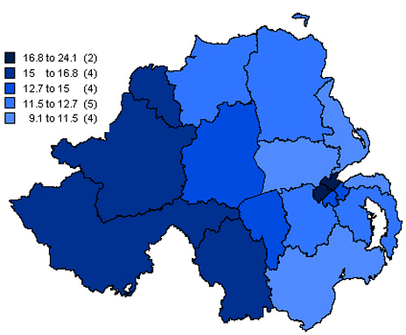

Slide 11
Suicide rates, Westminster constituencies, 2009-11

Slide 12
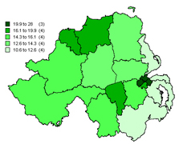
Suicide rates, Westminster constituencies, 2009-11

Slide 13
Explanations:
Changes in reporting and recording
Changes in mental illness and/or service provision
Changes in behaviour change: alcohol and drugs
Changes in protective factors: religion, family life and normative expectations
Economic change: recession and unemployment
Legacy of conflict

Slide 14
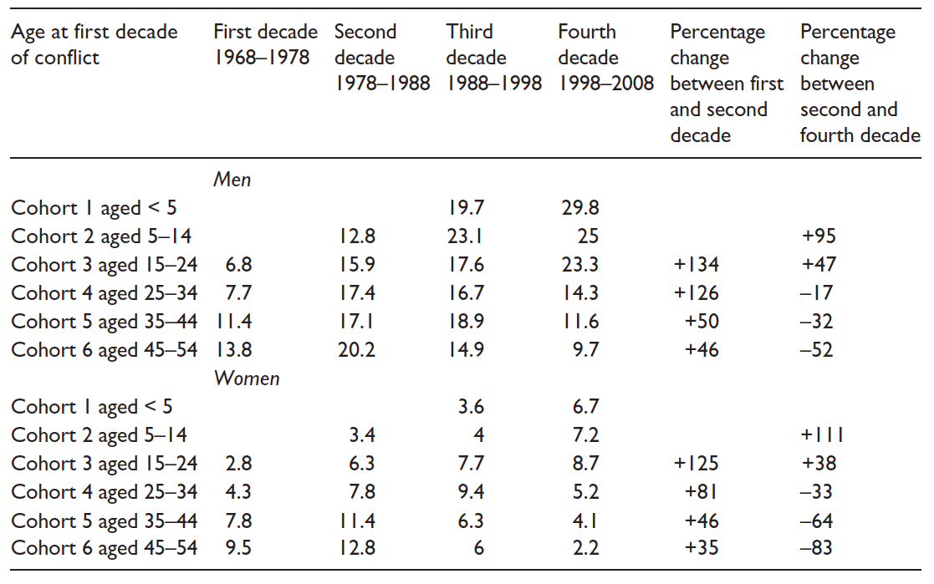

Slide 15
5-14

Slide 17
Implications of suicide as legacy of conflict :
Alter perspectives on prevention
2. Adjust identification of at-risk individuals, groups and communities
Improve data analysis and sociological autopsy to sharpen understanding of risk and the disconnect between services and those in need
Inform ongoing suicide awareness training among gatekeepers of services and resources
Change focus of public health strategies to address mass medication in middle and older age groups

