Slide 1
Residential segregation patterns in Northern Ireland through time: growing apart or growing together?
Ian Shuttleworth, QUB
i.shuttleworth@qub.ac.uk

Slide 2
Introduction: Some questions
How and why have levels of segregation appeared to have remained constant in NI between 1991 and 2001, and perhaps after 2001?
Why are segregation levels often slow to change?
In what circumstances does migration fail to redistribute population in such a way as to make major changes in population distributions?
How can population distributions change so as to increase or decrease segregation levels?

Slide 3
Residential segregation by religion 1971-2001
Segregation levels in NI grew between 1971 and 2001 but did not increase between 1991 and 2001 (Lloyd and Shuttleworth 2009)
Using 1km grid data
1971-1991
  Loss of population from Belfast – Catholic proportional increase on falling numbers
  Growth of the Catholic share
  Greater concentration of the Catholic population

Slide 4
Residential segregation by religion 1971-2001
1991-2001
  Greater Catholic proportion but
  No greater concentration
  No massive change in the population of Belfast
  No increase in residential segregation
Conclusion
  True that residential segregation grew 1971-2001
  But little change after 1991
What is the position now??

Slide 5
After 2001 – Migration and population change
Insights for changes after 2001 from
  The Northern Ireland Longitudinal Study (NILS); 28% sample of the NI population
  Data for migration events 2001-2007 from health registration data
  Population aged 25-74 – excludes students and the very old
Indicates some likely trends about what we might expect to see when 2011 Census results are released in 2013

Slide 6
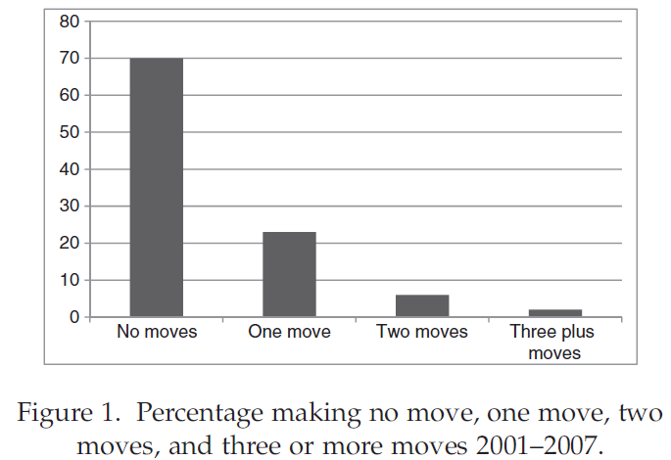
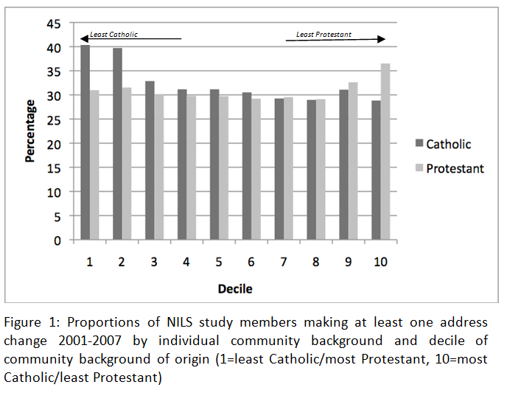
Results: Descriptives

Slide 7
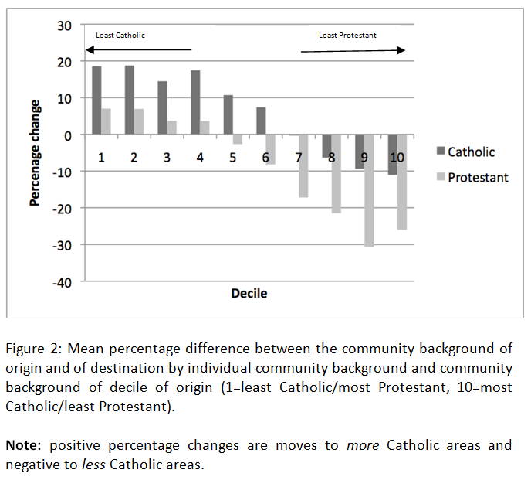
Results: Descriptives

Slide 8
Education and moves to and from deprived areas

Slide 9
Moving between places: How much difference?

Slide 10
Interpretations: Migration in a stable state?
Previous slides suggest why segregation levels in NI might have remained steady since 1991
Not many people move
This is because of short distance migration – and NI not an exception in this – in the context of existing population geographies
These structure the types of moves that are possible, downplaying the role of individual choice, and by default lead to stability

Slide 11
Interpretations: Migration in an unstable state?
Despite stability over much of the past two decades, segregation has increased in the past
The last large increase was 1971-1991, but there have been others before (eg in the 1920s)
This pattern has been known as the ‘segregation ratchet’ (Boal 2002) in which disequilibria (eg upsets) are followed by stability

Slide 12
Interpretations: Migration in an unstable state?
Boal (2002) terms these ethnonational ‘earthquakes’ – eg partition, the start of the troubles
These might move enough people, over long enough distances, to reshape rather than fall within existing population geographies
However, other forces may also be important besides politics
Belfast, for example, lost c200,000 people between 1971 and 1991 – a common experience of deindustrialisation and counterurbanisation?
We also do not know enough about other components of population change such as births and deaths

Slide 13
Implications
Predictions: no segregation increase 2001-2011 when Census results appear in 2013 or else natural increase/decrease are more important than migration
However, despite expressed preferences for mixed religion/community neighbourhoods in surveys, Catholics and Protestants tend to move to different kinds of places
Also, migration serves to sort people by social and economic status, with poorer people remaining in poorer areas

Slide 14
Implications
The overall outcome is that existing levels of migration do not offer a route either to greater residential mixing by religion or social background
If religious integration in housing is the policy aim, then existing levels and types of mobility are insufficient to achieve this aim
Given existing levels of segregation too few people move (and move long enough distances), to change segregation levels

Slide 15
Implications
There is also little evidence that migration offers a route to upward social mobility for everyone
The linkage of the NILS to the 1991 and 2011 Censuses will give a twenty-year perspective on the social, religious, and spatial mobility of the Northern Ireland population

