Slide 1
A new vision for the education of children and young people in custody
Tracy Irwin and John McCord

Slide 2
Who are we?
John McCord
  Legal background
  Young people’s rights
  School of the Built Environment
Tracy Irwin
  Essential Skills background
  Prison education
  School of Education

Slide 3
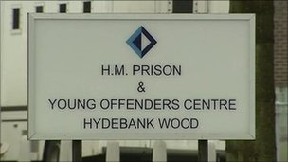

The Prison

Slide 4
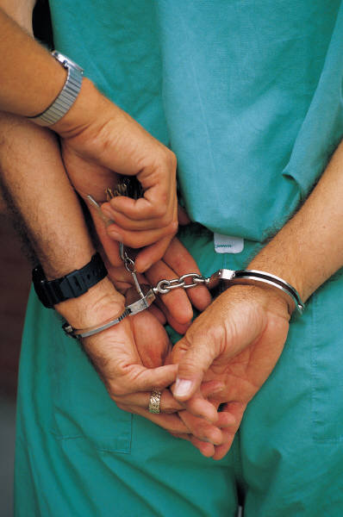
The Prison
Architecturally hostile
Barbed wire
Bullying
Drugs
Self harm
Violence
NOT CONDUSIVE TO LEARNING

Slide 5
The Prison
Human dustbins (Parker, 1997, p.16)
Most people simply do not want to know, or be ‘bothered’ about prisoners and prisons (Reuss, 2003, p.430)
A site of humiliation and failure that merely replicates previous experience of school (Bayliss, 2003, p.160)

Slide 6
Profile – young people in custody
Literacy and numeracy deficits
High levels of dyslexia
Mental health difficulties
Disrupted family lives
Drug/alcohol addictions
Poor experiences of school
Negative learning identities

Slide 7
The learners
Prisoner as: | Learner as:
Drug dealer | Individual
Joy rider | Person with potential
Burglar | Learner
Rioter | Citizen
Negative | Positive
Criminality | Rehabilitation

Slide 8

Prison education
Replicates school based environment
Learning linked to behaviour
Northern Ireland curriculum
Emphasis on employability
Limited use of technology
No specific training for prison teachers

Slide 9
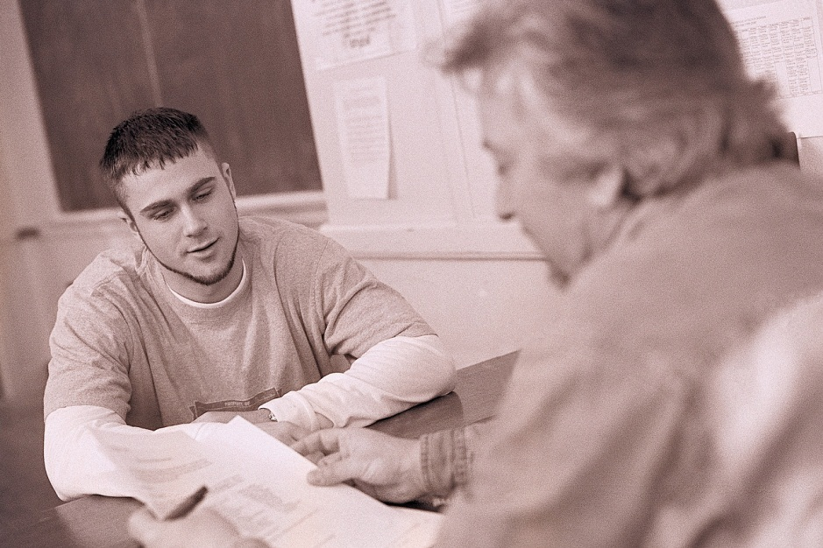
A new vision
Humanistic
Self-directed learning approaches
Experiential approaches
Social learning
Shared learning
Contextualised

Slide 10
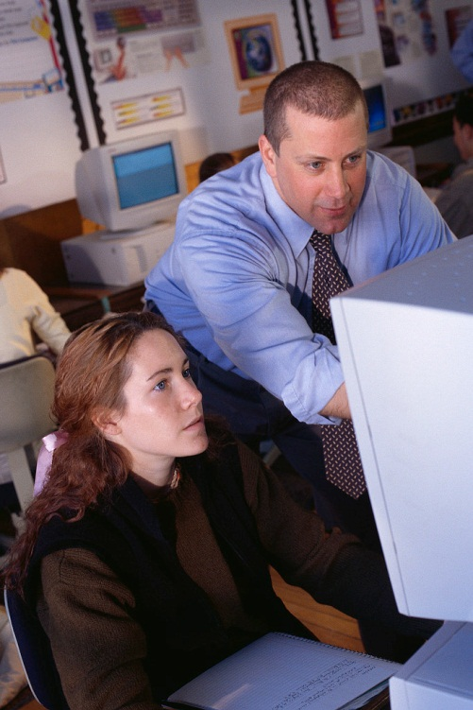
A new vision
Learning wings
Offender campuses
Communities of practice
Elearning community
Culture of learning
External links
Rehabilitation

Slide 11

Thank you – any questions?

