Slide 1
Minimising harm from alcohol misuse:
Challenges to the development of effective policy
© nTrance used under a Creative Commons 2.0 license

Slide 2
Understanding harms and costs of alcohol use
John Moriarty

Slide 3
What harms accrue from Alcohol use?
Routes to estimation
Aggregating individual-level harms
Aggregating cost to the exchequer
Comparing the harms born by the individual themselves to those born by others

Slide 4
Which others are harmed?
Work Colleagues
Household
Drinker
Strangers
Family
Friends
Reproduced from
Laslett et al. 2010, p.5

Slide 5
What’s still missing?
Peer influence and feedback loops

Slide 6
Children in Household / Family
Strangers
Drinker
Direct Harm
Social Influence
Work Colleagues
Adults in Household / Family
Friends

Slide 7
What’s still missing?
Peer influence and feedback loops
Thresholds where use becomes harmful

Slide 8
Children in Household / Family
Strangers
Drinker
Harm Threshold
Work Colleagues
Adults in Household / Family
Friends

Slide 9
What’s still missing?
Peer influence and feedback loops
Thresholds where use becomes harmful
Harms born in the long versus short run

Slide 10
Translating research on alcohol related harms into effective policy
Andrew Percy

Slide 11
Reducing complexity
Reduce diversity
Downplay continuity
Dismiss social context

Slide 12
Do different patterns of teenage drinking produce different adult outcomes?
Hazardous drinkers
Heavy drinkers
Moderate drinkers
Occasional drinkers
Limited drinkers
Units
Heavy sessional drinking
Mental health
SES
Controlling for a large range of childhood and adolescent confounders
@ age 16
@ age 26

Slide 14
How different is teenage drinking from adult drinking?
Teenagers drink to be sociable, to celebrate, to commiserate, to relax, to have a good time with friends.
Just like adults

Slide 15
How different is teenage drinking from adult drinking?
For most teenage drinkers, passing out, being sick, getting into fights, having to be looked after by your friends are all highly embarrassing incidents.
Just like adults

Slide 16
How different is teenage drinking from adult drinking?
Teenage drinkers use a range of strategies to regulate their consumption developed through trial and error.

Slide 17
Does social context (people and places) matters in alcohol related harms?
We collect data from individuals, we analyse individuals, we graph individuals, we design interventions for individuals.
BUT
Teenage drinking is done in groups

Slide 18
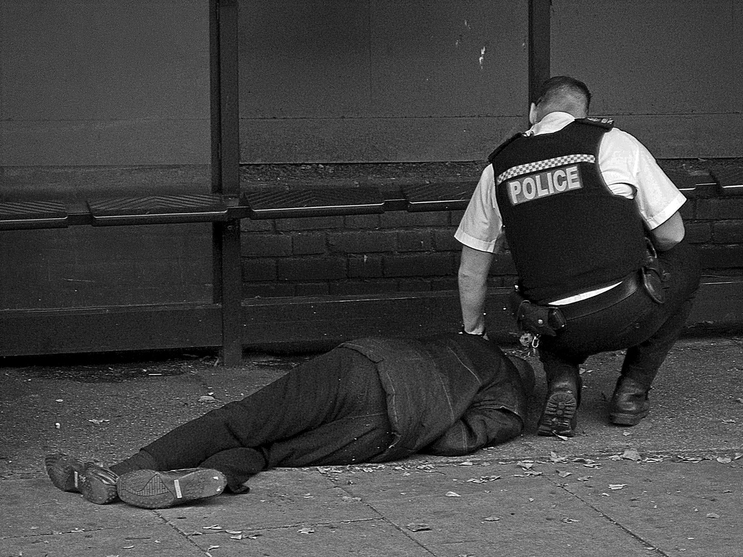
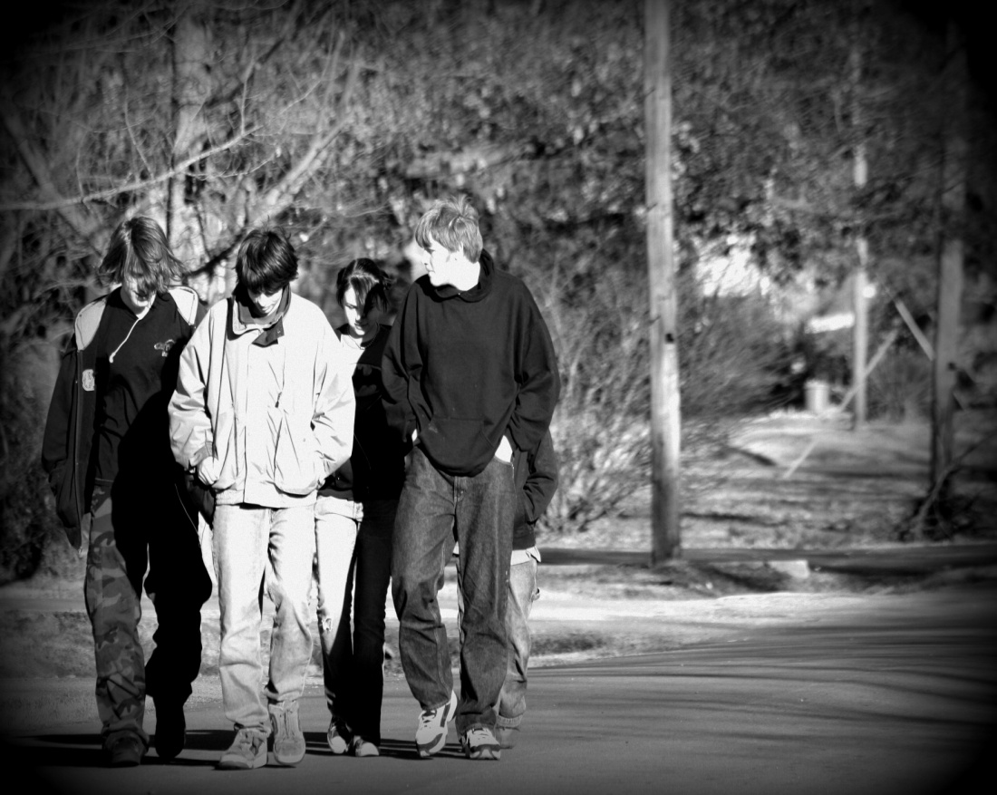
Implications?
Teaching drinking skills to moderate teenage drinkers to reduce harms associated with acute intoxication
Providing interventions for groups of teenagers
© St Stev creative commons license
Implications
Reducing consumption amongst heavy and hazardous drinkers
Recognise and embrace the complexity of teenage development

